Slide 1
Teck Ghee Horizon 464

Slide 2
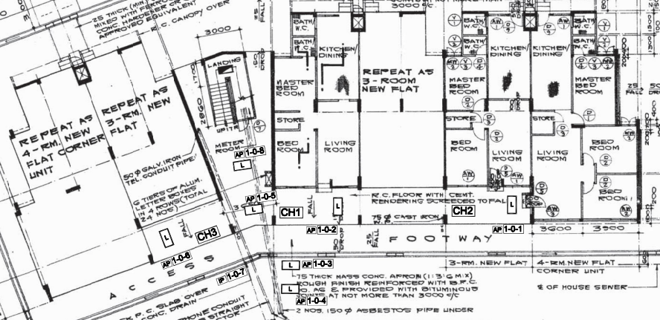
Block 464 1st STOREY FLOOR PLAN

Slide 3
STAIR
1086
1084
1082
1080
1088
1090
COMMON CORRIDOR
LOBBY
A

Slide 4
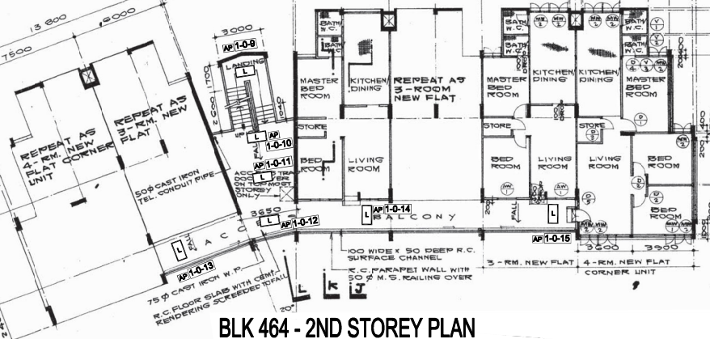
Block 464 2nd TO 4th STOREY FLOOR PLAN

Slide 5
STAIR
1086
1084
1082
1080
1088
1090
COMMON CORRIDOR
LOBBY
A

